Slide 1

MODY UNIVERSITY OF SCIENCE AND TECHNOLOGY
SCHOOL OF ENGINEERING AND TECHNOLOGY
DATA STRUCTURES LAB (CS-14.223)
PROJECT BASED LEARNING-PHASE II
SUBMITTED TO -
Dr. Puneet Kumar Gupta
Mr. Hitesh Jangir
SUBMITTED BY-
NIDHI CHOUDHARY(180074)
HIRAL JAIN(180167)
AKSHITA KANTHER(180161)
SIMRAN JAIN(180181)

Slide 2

Implementation of undo & redo operation on string using stack

Slide 3

CONTENTS
Introduction
Language used & data structure
Stack
Push & pop operation in stack
undo
redo
Summary
applications
bibliography

Slide 4
INTRODUCTION
Undo and redo are an interactive technique which is implemented in many computer programs. It erases the last change done to the document or string reverting it to an older state. with the possibility of undo, users can explore and work with the programs without fear of making mistakes because it can easily be undone. the opposite of undo is redo. the redo command reverses the undo. in most windows applications, the undo command is activated by pressing the ctrl+z or alt+backspace keybindings. the common command for redo on microsoft windows systems is ctrl+y or ctrl+shift+z.

Slide 5
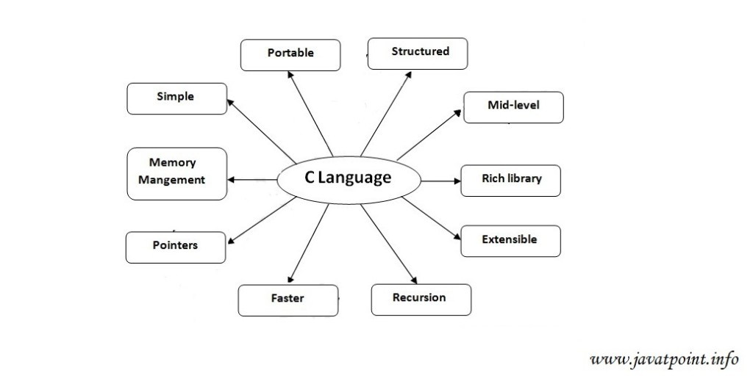
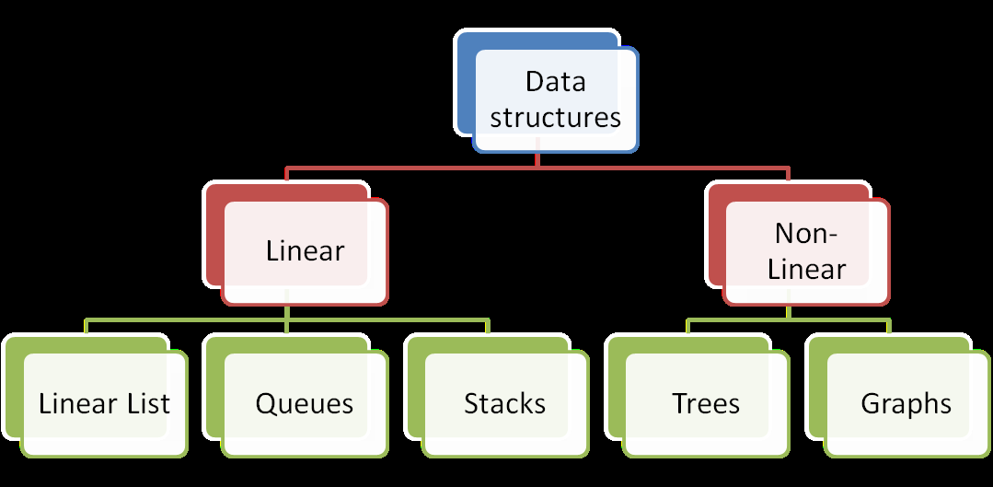
C programing language:-
C is a procedural programming language. It was initially developed by Dennis Ritchie as a system programming language to write operating system. C programming is considered as the base for other programming languages, that is why it is known as mother language.
DATA STRUCTURE IN C
Data Structure is a particular way of organisation, management, and storage format that enables efficient access and modification. More precisely, a data structure is a collection of data values , the relationships among them.
Fig: Features of C
Fig: Data structure

Slide 6
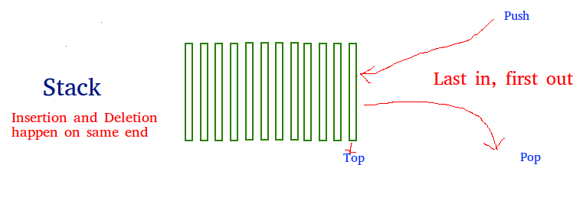
STACK
Stack is a linear data structure which follows a particular order in which the operations are performed. The order may be lifo(last in first out) or filo(first in last out).
There are many real-life examples of a stack. Consider an example of plates stacked over one another in the canteen. the plate which is at the top is the first one to be removed, i.e. the plate which has been placed at the bottommost position remains in the stack for the longest period of time. So, it can be simply seen to follow lifo(last in first out)/filo(first in last out) order.

Slide 7
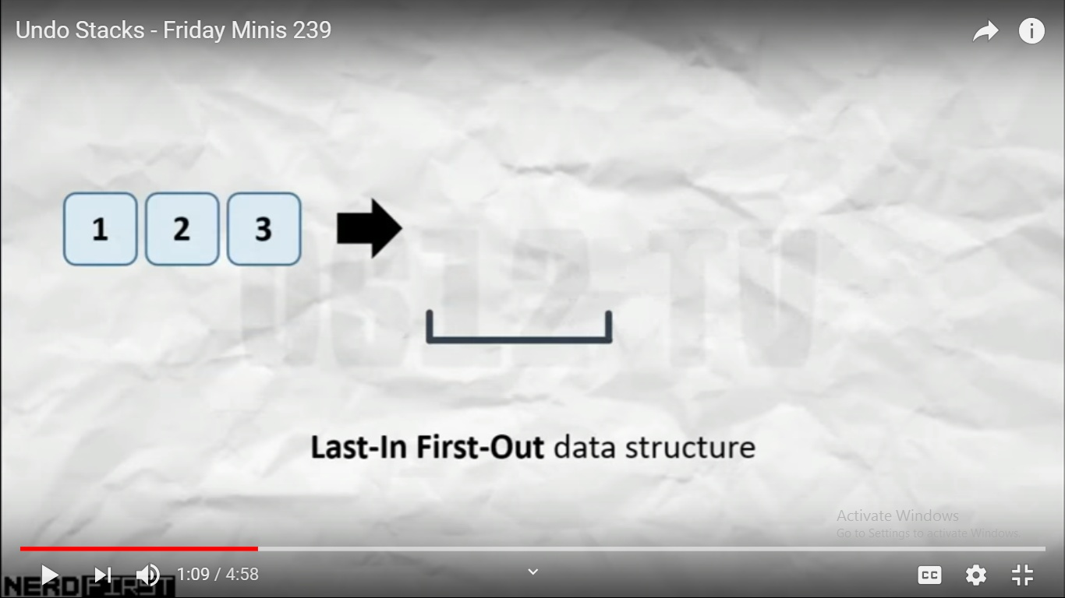
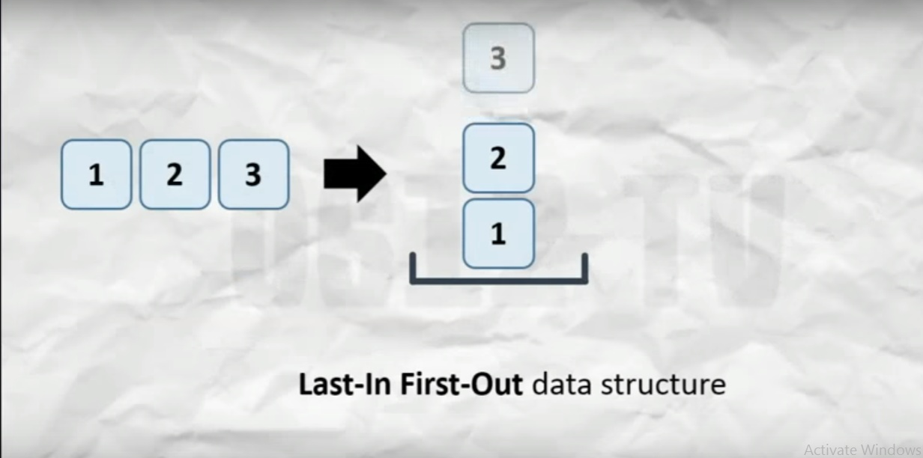
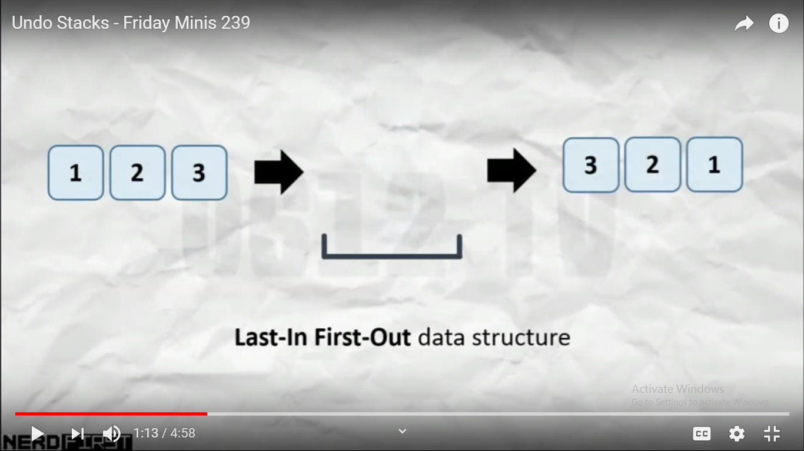
Why stack ?
Stack data structure is most suitable to implement redo-undo feature. This is because the stack is implemented with lifo order which is equivalent to redo-undo feature.

Slide 8
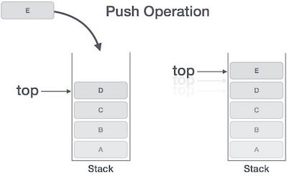
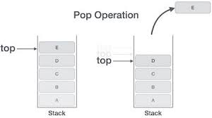
Push and pop opErations in stack
Push: Adds an item in the stack. If the stack is full, then it is said to be an Overflow condition.
Pop: Removes an item from the stack. The items are popped in the reversed order in which they are pushed. If the stack is empty, then it is said to be an Underflow condition.

Slide 9
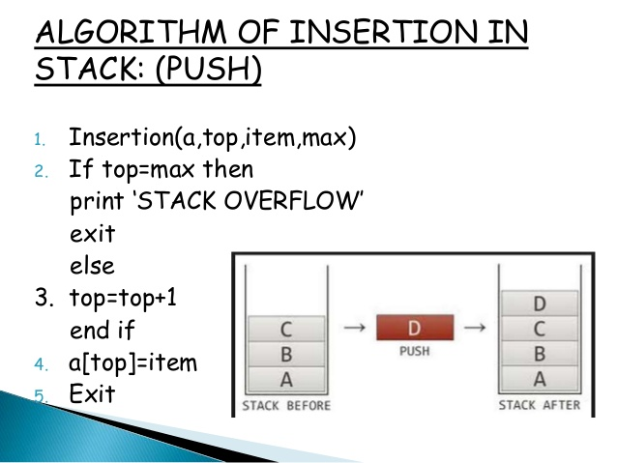
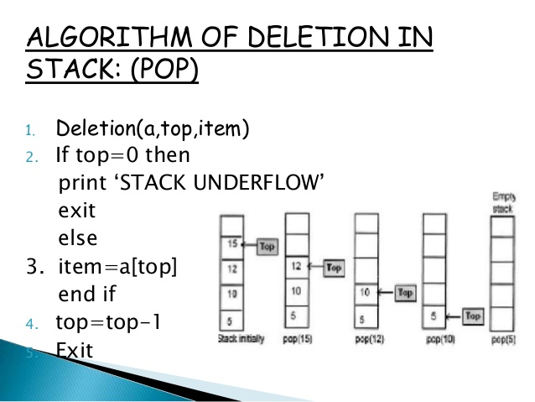
ALGORITHM

Slide 10
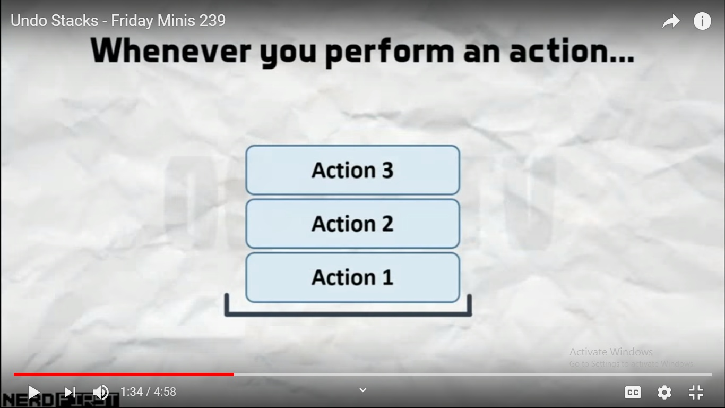
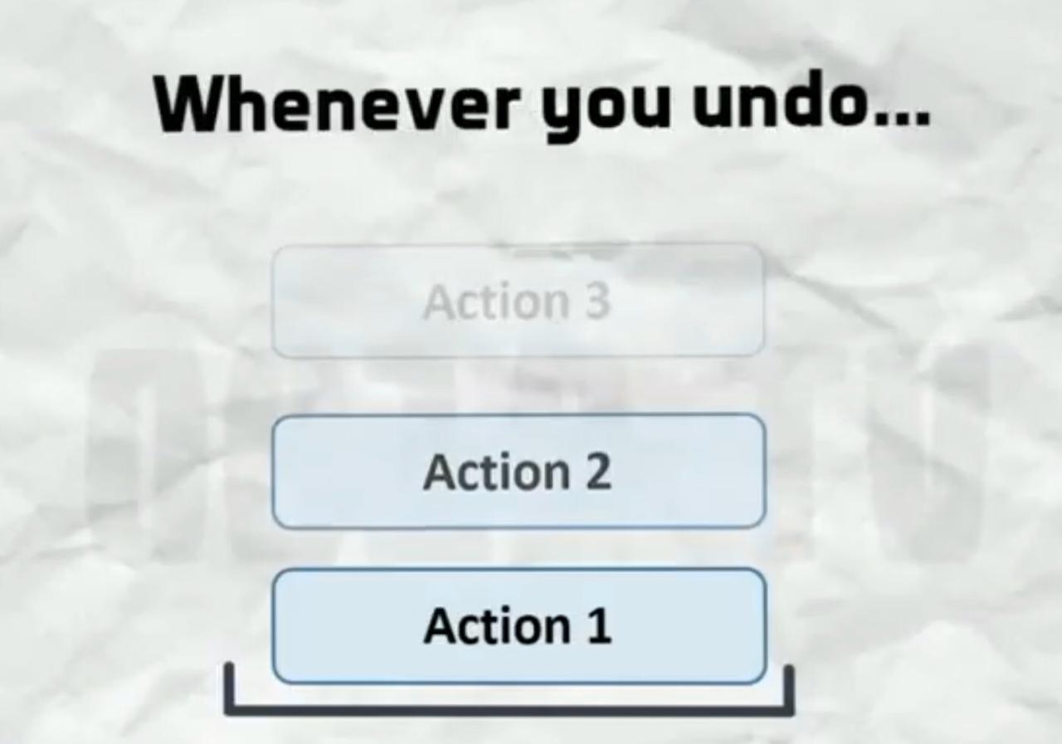
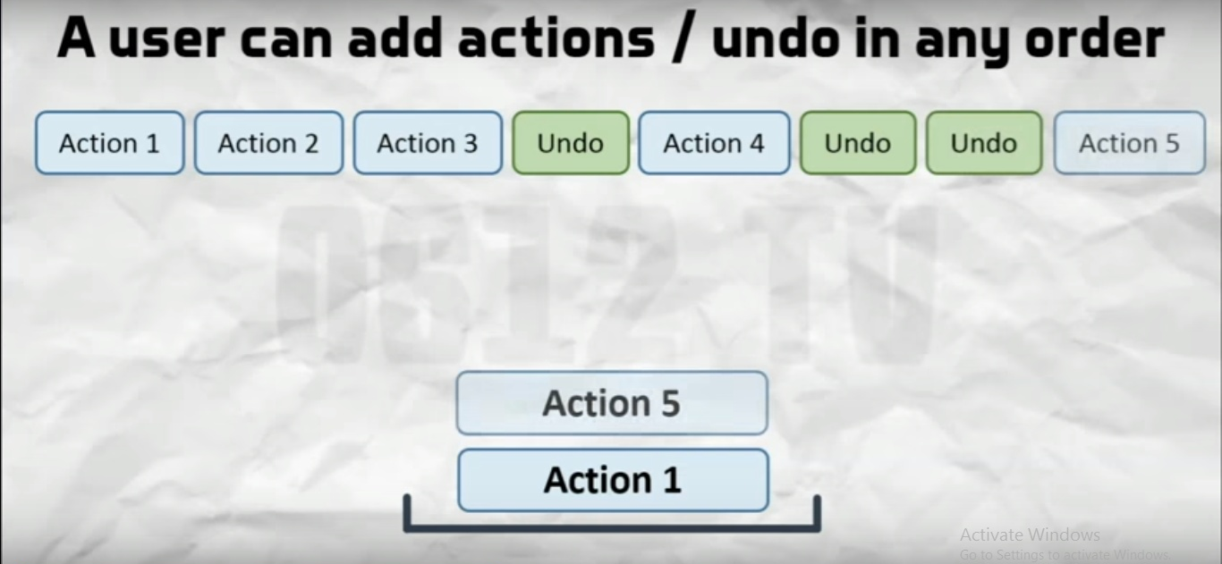
Undo
Last in first out that is what undo is doing which means that last action we have performed is the first action we are going to reverse. If we do undo again ,the second last action will be reversed again and so on until the entire stack exhausts.
After performing the undo the user has two option either to perform the action or to undo again.

Slide 11
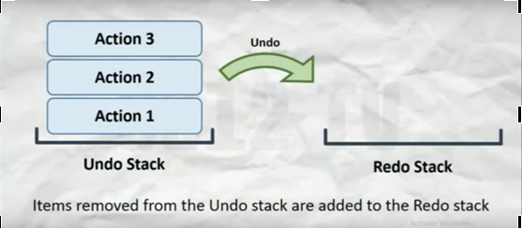
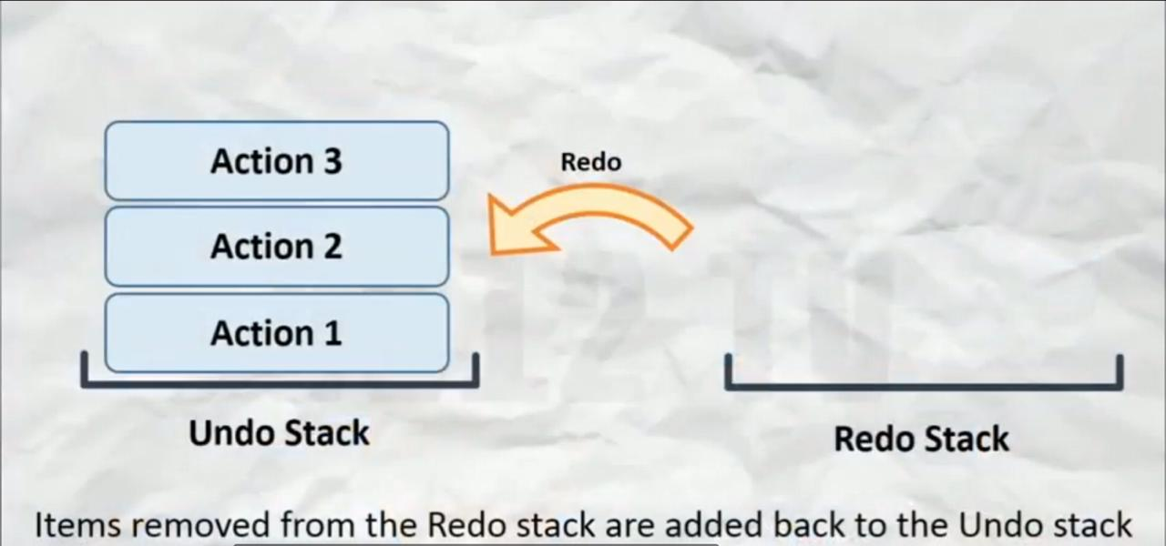
REDO
Redo is basically reverse of undo operation.
For redo , we require one more stack.
Each time we perform the operation we remove the item from undo stack and add it to the redo stack.
When the user say redo , we move the item from the redo stack to the undo stack that is we do all the actions in the opposite direction.

Slide 12
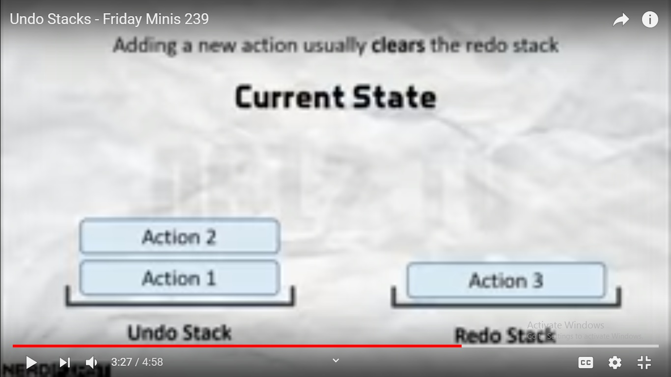
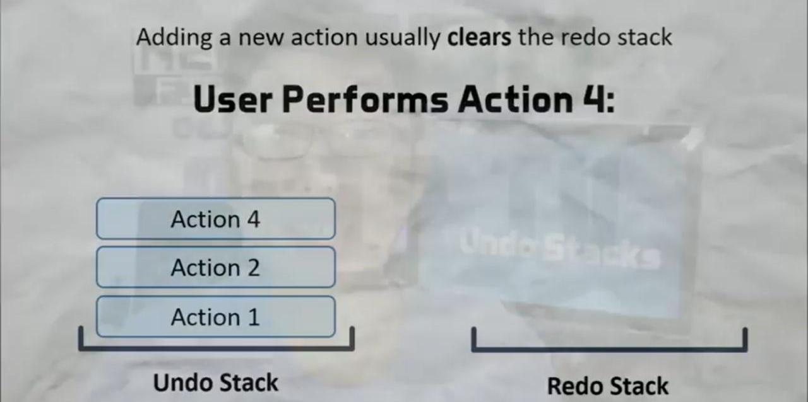
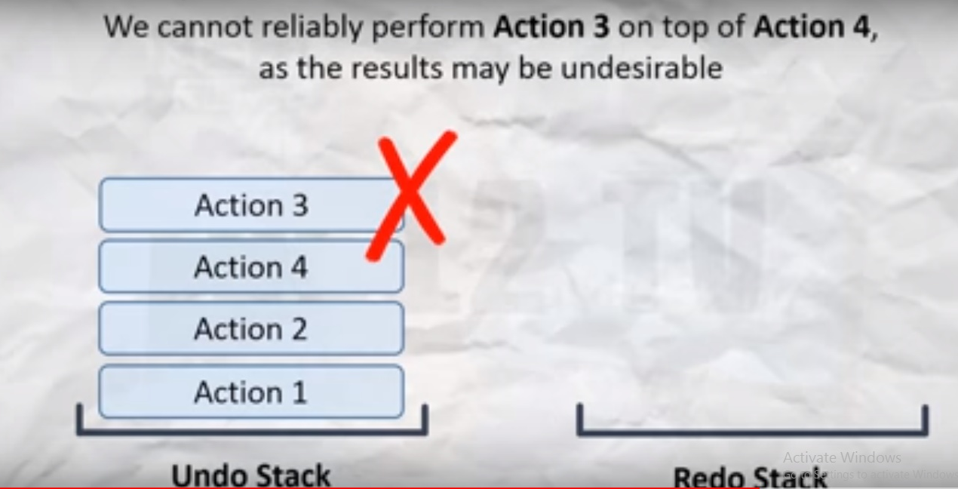
There is one limitation that if we have undone several steps and we perform a brand new action we lose the ability to redo because if we try to redo it may lead to inconsistency in the final results .
If we have done the steps several times and then perform new actions the redo stack becomes clear .We can no longer recover those items .

Slide 13
SUMMARY
The best way to look at undo/redo is two stacks of operations the user has performed:
The undo stack is the history of what they have done
The redo stack is basically back to the initial state before they started undoing
So, as the user does something in the application,we push an action onto the undo stack.
If the user ‘undos’ an action,we pop off the undo stack,do the operation,then we push an action onto the redo stack.

Slide 14
APPLICATIONS
MICROSOFT OFFICE –POWER POINT, EXCEL, WORD
IN MOST WINDOWS APPLICATIONS, THE UNDO COMMAND IS ACTIVATED BY PRESSING THE CTRL+Z OR ALT+BACKSPACE KEYBINDINGS. IN ALL MACINTOSH APPLICATIONS, THE UNDO COMMAND IS ACTIVATED BY PRESSING COMMAND-Z. THE COMMON COMMAND FOR REDO ON MICROSOFT WINDOWS SYSTEMS IS CTRL+Y OR CTRL+SHIFT+Z. THE COMMON COMMAND FOR REDO ON APPLE MACINTOSH SYSTEMS IS COMMAND-SHIFT-Z.

Slide 15
BIBLIOGRAPHY
Data Structures and Algorithms by Alfred V.Aho
Wikipedia
https://www.quora.com/
www.youtube.com

Slide 16


